Slide 1
Is the Cuzco Quechua plural marker -kuna optional?
Liliana Sánchez
University of Illinois Chicago
Janett Vengoa
Independent Researcher (Peru)
5/ 11/23

Slide 2
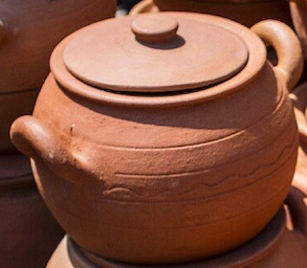
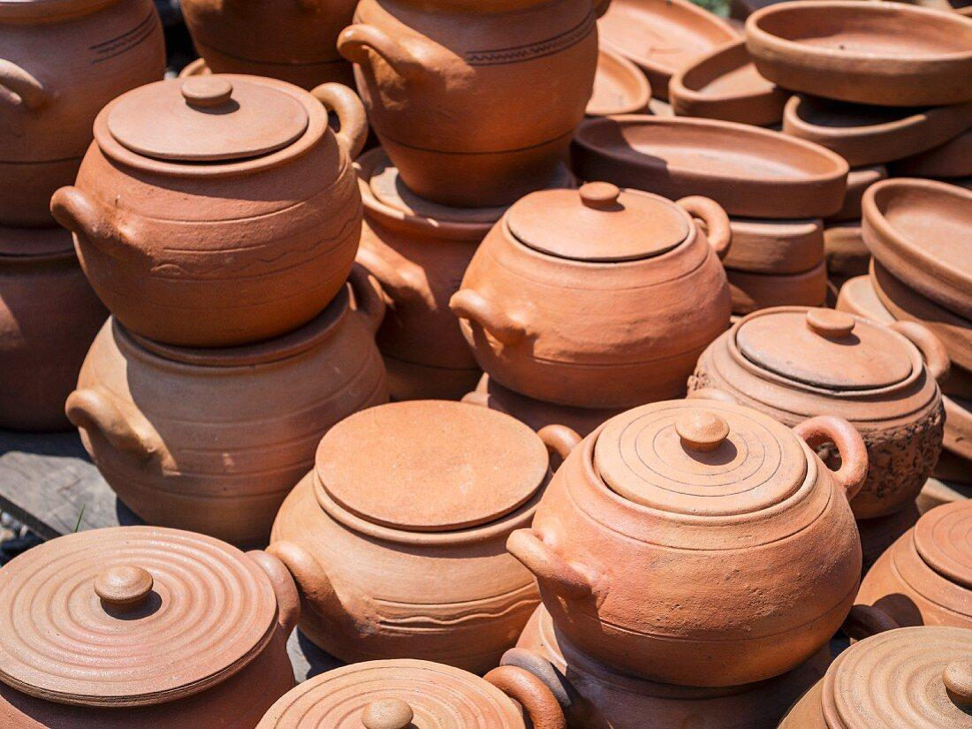
Quechua Nouns and Number
Manka-ta ranti-rqa-ni
Pot-ACC buy-PST-1.S
“I bought a pot/pots.”
Faller (2007): Cuzco Quechua nouns
have general number.

Slide 3
Quechua nouns and -kuna: an “optional” number suffix?
Faller (2007)
Nouns in CQ have a cumulative denotation.
The suffix -kuna is an optional plural that enforces a plural interpretation:
(2) Uwiha-q qhepa-n-ta urqo-ta ri-spa-n, . . .
sheep-GEN behind-3-ACC mountain-ACC go-NMLZ.SS-DIR
‘Walking behind the sheep (pl.) to the mountains . . .’. (‘Yendo a los
cerros tras las ovejas . . .’.)
(Faller 2007:272 from Valderrama Fernandez & Escalante Gutierrez 1982: 26)
(3) Urqo-pi hina uwiha-cha-kuna michi-mu-sqa-y-man
mountain-LOC like sheep-DIM-PL herd-CIS-NMLZ-1-ILLA
hina . . .
like
“As I was herding the sheep in the mountains . . .”
(Faller 2007: 272, from Valderrama Fernandez & Escalante Gutierrez 1982: 26)

Slide 4
The distribution of nouns with -kuna
We will present the distribution of nouns marked with -kuna to show that they may denote more than a simple plurality of referents.
Nouns marked with -kuna may refer to a:
Group with members of different types
Plurality of groups of different types
Plurality of individuals
Depending on various criteria:
Syntactic position
Animacy
Number marking on the verb
Status of the noun referent (identifiable/ non-identifiable).

Slide 5
Number Marking: Standard vs. Strict pluralization
(4) English:
(i) a singular form (with a null singular morpheme?) which is possibly unmarked.
⟦N⟧ = a set of atoms: {a, b, c}
(ii) a marked form with a plural morpheme:
⟦N_{PL}⟧ = a set of atoms and plural individuals:
{a, b, c, a+b, b+c, a+c, a+b+c}
(5) Cuzco Quechua:
[[N]] = {a, b, c, a+b, b+c, a+c, a+b+c}
Languages with strict pluralization, on the other hand, would show a basic form that ranges over a domain of atomic forms while plural forms would be the domain of strictly plural individuals, sums minus their atomic parts.
We will present the distribution of the so-called ‘optional’ plural form -kuna to determine the extent to which it can be considered a marker of strict plurality with animate and inanimate nouns in subject and object position.

Slide 6
Subjects (Animates and Inanimates)

Slide 7
Unmarked Inanimate Subjects
(5)a. Ima-taq urma-ya-mu-n?
What-CONT fall-INT-TRANSLOC-3S
“What fell?”
b. Manka-taq urma-ya-mu-n (*-nku)
Pot-CONT fell-INT-TRANSLOC-3S (*-3.PL)
“A pot/ a group of pots fell”
(not a group of other things)
(i) pot-1 ‘manka’ + singular V
(ii) pot-1+pot-2+pot-3 ‘manka’ + singular V

Slide 8

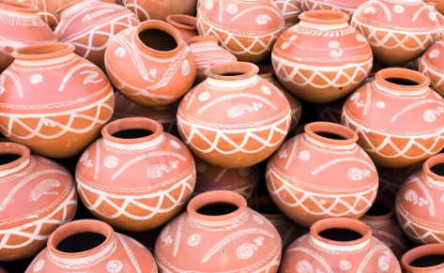
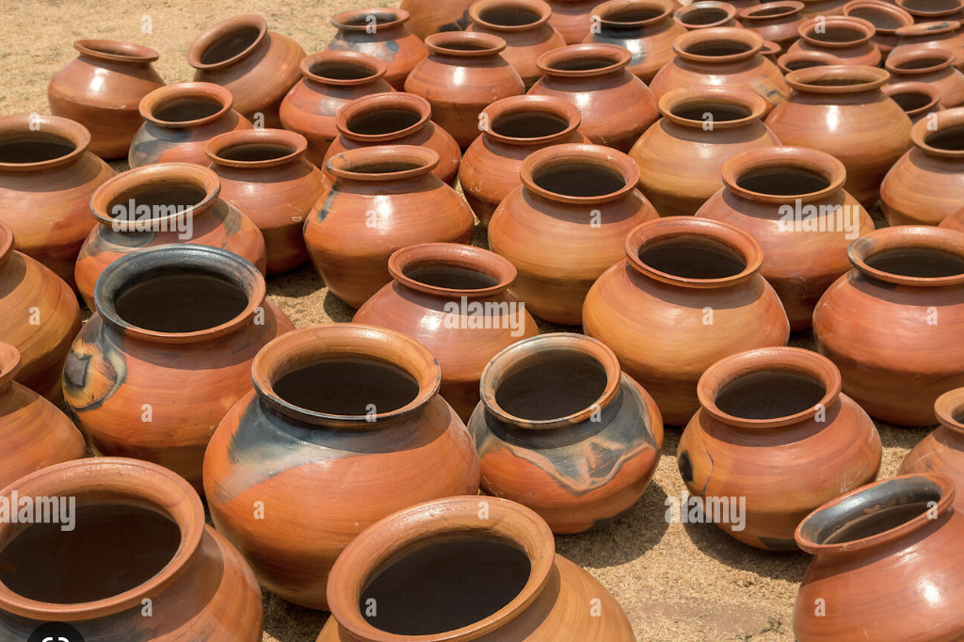
Inanimate Subjects with -kuna
(i) ↑pot-T1+ pot-T2+pot-T3
‘manka-kuna’ + singular V
(fell)
(ii)↑(pot-1+pot-2+pot-3)-T1+↑(pot-4+pot-5+pot-6)-T2+
↑(pot 7+pot 8+ pot 9)-T3
‘manka-kuna’ + plural V
(fell)
(6) a. Ima-taq urma-ya-mu-n?
Indef-CONT fall-INT-TRANSLOC-3S
What fell?
b. Manka-kuna-taq urma-ya-mu-n
Pot-PL-CONT fell- INT-TRANSLOC-3S
“A group of pots of different types fell.”
c. Manka-kuna-taq urma-ya-mu-nku
Pot-PL-CONT fell- INT-TRANSLOC-PL
“Several groups of pots/ Some pots from
different groups fell.”
Notes:
This is not strict pluralization in than the predicate doesn’t have apply to all individuals in the group, but the formation of groups is obligatory

Slide 9

Unmarked Animate Subjects
(7) a. Pi-taq urma-ya-mu-n?
Indef.ANIM-CONT fall-INT-TRANSLOC-3.S
“Who fell?”
b. Yachaq-mi urma-ya-mu-n.
Student-FOC fall-INT-TRANSLOC-3S
“The student fell”
(identifiable/presupposed?)
Note: Infelicitous if more than one fell

Slide 10


Animate Subjects with -kuna
(8) a. Pi-taq urma-ya-mu-n?
Indef.ANIM-CONT fall- INT-TRANSLOC-3S
“Who fell?”
b. Yachaq-kuna-n urma-ya-mu-n
Student-PL-FOC/EVID fall- INT-TRANSLOC-3S
“The students fell.”
(a plurality of individuals, not identifiable)
c. Yachaq-kuna-n urma-ya-mu-nku
Student- PL-FOC/EVID fall- INT-TRANSLOC-3PL
“The students fell.”
(a plurality of individuals that I can identify)
Notes:
Group formation is not obligatory

Slide 11
Direct Objects (Animate and Inanimate)

Slide 12
Unmarked Inanimate Objects
(9) a. Ima-ta-taq riku-nki?
Indef-ACC-CONT see-2.S
“What do you see?”
b. Manka-ta-m
Pot-ACC-FOC/EVID
“Pot/s”
(number neutral)

Slide 13




Inanimate Objects with -kuna
a. Ima-ta-taq riku-nki?
Indef-ACC-CONT see-2.S
“What do you see?”
b. Manka-kuna-ta-m.
Pot-PL-ACC
“Different types of pots”
A) a group of pots of different types, B) a plurality of groups of pots of different types, C) a combination of A+B
A
B
C = A + B

Slide 14
Inanimate objects with –kuna (2)
(11) a. Manka-kuna-ta waqaycha-rqa-nki-chu?
Pots-PL-ACC sort out-PST-2.SG-INT
“Did you sort out the (different types of) pots?”
b. Arí, waqaycha-rqa-ni-n
Yes, sort out-PST-1.S-EVID.DIR
“Yes, I did.”
In object position:
Unmarked inanimate nouns are number neutral.
Nouns marked with -kuna refer to groups

Slide 15
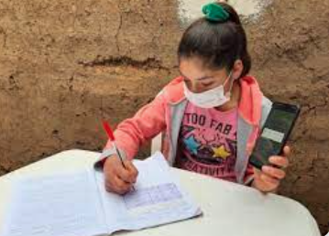

Unmarked Animate Objects
(12) a. Ima-ta-taq riku-nki?
Indef-ACC-CONT see-2.S
“What do you see?”
b. Yachaq-ta-n riku-ni
Student-ACC-FOC/EVID see-1.S
“I see a student/students”
(non-presupposed, number neutral)

Slide 16
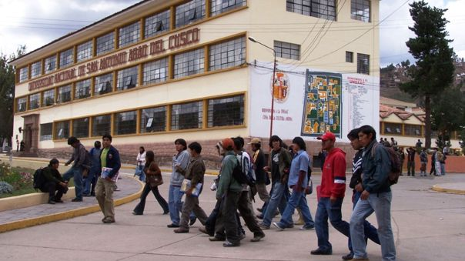
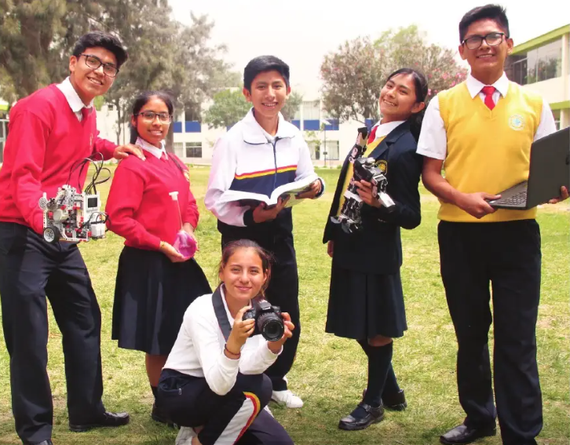
Animate objects with -kuna
(13) a. Ima-ta-taq riku-nki?
Indef-ACC-CONT see-2.S
“What do you see?”
b. Yachaq-kuna-ta-n riku-ni
Student-PL-ACC-FOC/EVID see-1.S
“I see (a group of) students”

Slide 17
Is -kuna a marker of strict plurality?

Slide 18
Inanimates
Syntactic position | Interpretation
Unmarked Subject | An individual or a group (V must be singular)
Unmarked Object | An individual or a group
Subject with -kuna | V + Singular group of different types V +Plural multiple groups of different types (an individual of each group)
Object with -kuna | a) group of different types b) multiple groups of different types, c) a+b

Slide 19
Animates
Syntactic position | Interpretation
Unmarked Animate Subject | An individual (V must be singular)
Unmarked Animate Object | An individual or several individuals
Animate Subject with -kuna | V + Singular (a plurality of individuals, not identifiable) V +Plural a plurality of individuals that the speaker can identify
Animate Object with -kuna | a) group of different types b) multiple groups of different types

Slide 20
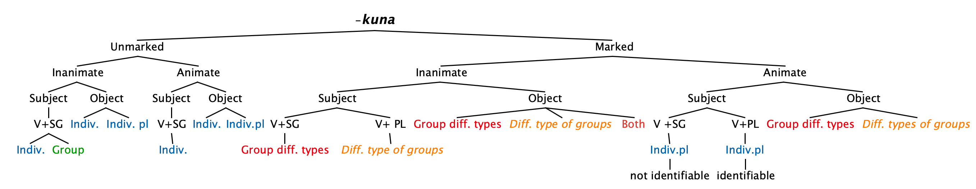
-kuna is a sorting mechanism, not a plural marker
-kuna is not an optional marker of plurality.
With inanimates, subjects and objects, or animate objects, -kuna is not needed for plurality. It introduces variety (single set with members of different types or different types of groups).
Unmarked animate subjects are not number neutral, and they interact with –kuna differently.
Notes:
-kuna is not an optional marker of plurality
Case 1: picture of boy falling from the earlier slide
-kuna is needed to shift to picture of plurality of people falling
Case 2: picture of a set of same pots
-kuna is not needed for plurality, so when it is added it introduces variety => picture of single set with different pots, picture of separate sets

